Slide 1
DataCamp Certification Presentation
Building a model to determine price of used BMW
Tom Halloin

Slide 2
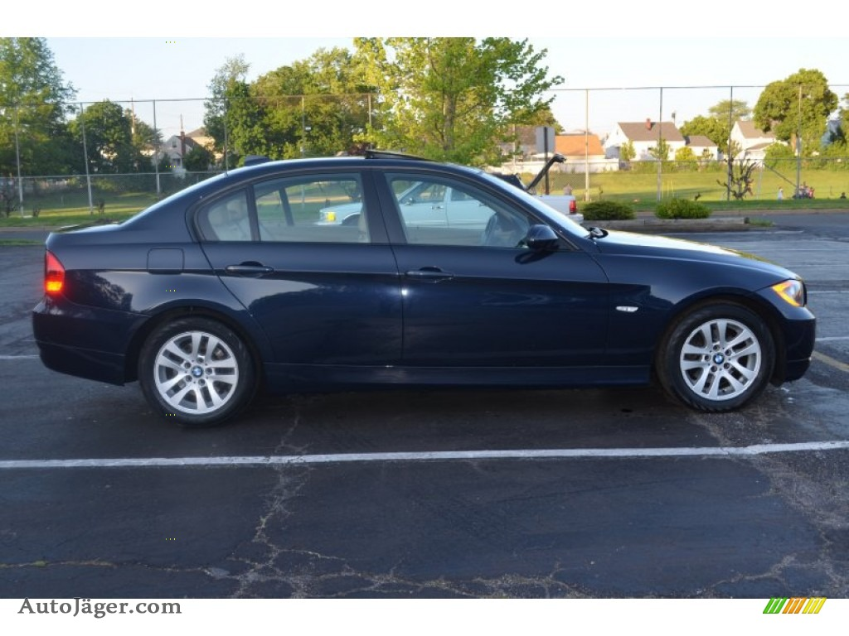
Story Time: Buying My First Car

Slide 3
Better Data -> Better Decisions
Goal: build a machine learning model to predict the price of a used BMW given features listed below given the following on ~10,000 cars.
Model
Year
Transmission
Mileage
FuelType
Tax
Miles Per Gallon (MPG)
EngineSize

Slide 4
The Plan
Identify suitable performance metric
Exploratory Data Analysis (EDA)
Determine possible machine learning models
Fit, tune, and validate models
Use models to price sample BMW

Slide 5
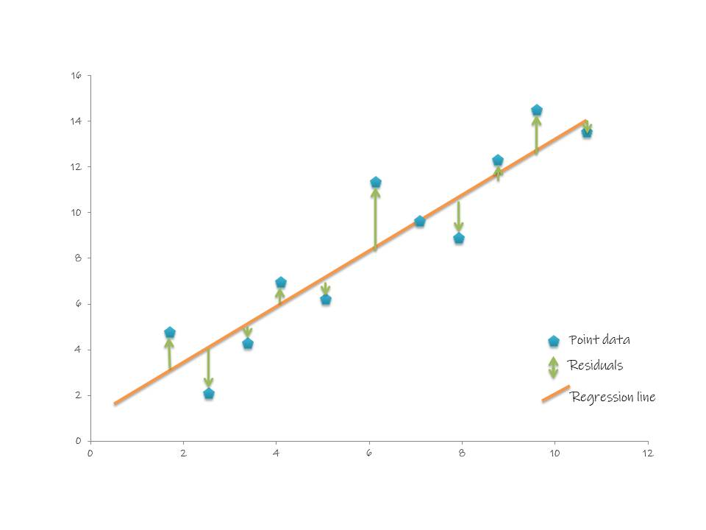
Ideal Metric – Root Mean Squared Error
Answers question “How much is the model off by on average?”
(No model will ever be perfect!)
Interpretable
(Dollars vs Squared dollars)
Minimize the green lines

Slide 6
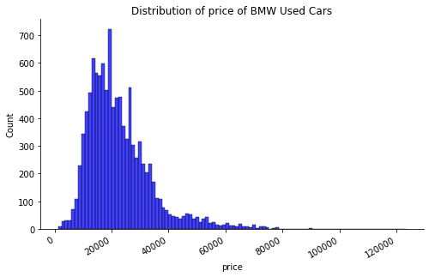
EDA Highlights – Price Distribution

Slide 7
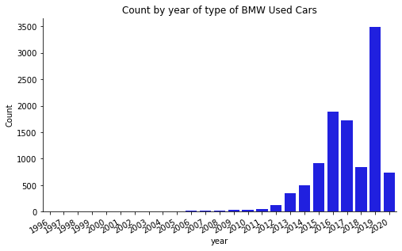
Count by Year of BMW Cars

Slide 8
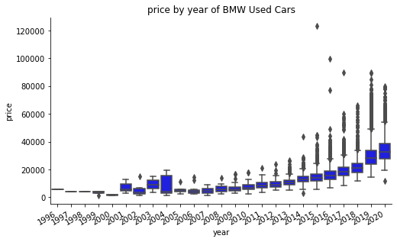
Price by Year of BMW Used Cars

Slide 9
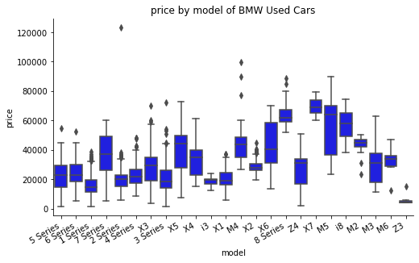
Price by Model of BMW Used Cars

Slide 10
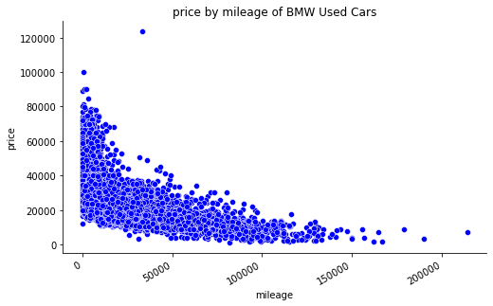
Price by Mileage of BMW Used Cars

Slide 11
Overall EDA Findings
One outlier needs to be removed.
The dataset is quite large, with 10,780 observations*.
The distribution of price is skewed towards more expensive cars.
As cars age and gain mileage, they depreciate in value.
Car model, while important, does not determine price alone.

Slide 12

Model Selection: Beyond the Black Box
Linear Regression
Random Forest
XGBoost

Slide 13
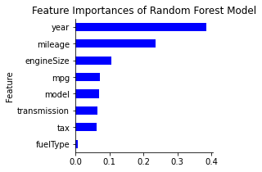
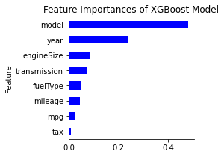
Feature Importances
Root Mean Squared Error: $2,424
Root Mean Squared Error: $2,281

Slide 14
Fitting the Models to sample
2007 BMW 3 Series with 116,068 miles today found online
Random Forest: $5,947
XGBoost: $4,260
2011 BMW 3 Series with 103,000 miles today (equivalent to buying same car when I bought it)
Random Forest: $8,850
XGBoost: $9,761
For context, paid ~$20,000 for car and had resale value of ~$2,000 when I sold it for parts.

Slide 15
Life Advice and Moral of the Story
Don’t buy a used BMW as your first car.

Slide 16
Picture References
https://hatarilabs.com/ih-en/how-to-calculate-the-root-mean-square-error-rmse-of-an-interpolated-ph-raster
http://autojager.com/car/65041553-10.html

